Slide 1
Sustitución Trigonométrica
Profesora: Patricia Cabrera Calavacero
Asignatura: Cálculo Integral y Series

Slide 2


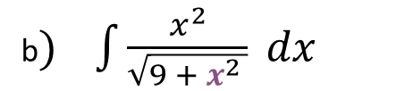
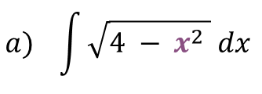
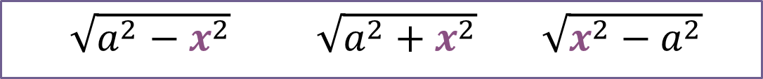
Introducción
El método de sustitución o cambio de variable trigonométrico lo utilizaremos cuando nos aparecen radicales de la forma
$\sqrt{a^{2}−x^{2}}$ $\sqrt{a^{2}+x^{2}}$ $\sqrt{x^{2}−a^{2}}$
Ejemplo
$$a) \int{\sqrt{4 − x^{2} } dx }$$
b$) \int{\frac{x^{2}}{\sqrt{9 + x^{2} }} dx }$
c$) \int{\frac{3x}{\sqrt{x^{2}−16 }} dx }$

Slide 3
Identidades trigonométricas
$${sen}^{2}θ+ \cos^{2}θ=1$$
〖𝒔𝒆𝒏〗^𝟐 𝜽+ 〖𝒄𝒐𝒔〗^𝟐 𝜽=𝟏
$$\sec^{2}{θ=1+\tan^{2} θ}$$
〖𝒔𝒆𝒄〗^𝟐⁡〖𝜽=𝟏+〖𝒕𝒂𝒏〗^𝟐 𝜽〗
$$\tan^{2}{θ=\sec^{2} θ−1}$$
〖𝒕𝒂𝒏〗^𝟐⁡〖𝜽=〖𝒔𝒆𝒄〗^𝟐 𝜽−𝟏〗
$$\cos^{2}{θ=1−{sen}^{2} θ}$$
〖𝒄𝒐𝒔〗^𝟐⁡〖𝜽=𝟏−〖𝒔𝒆𝒏〗^𝟐 𝜽〗
$${sen}^{2}{θ=1−\cos^{2} θ}$$
〖𝒔𝒆𝒏〗^𝟐⁡〖𝜽=𝟏−〖𝒄𝒐𝒔〗^𝟐 𝜽〗

Slide 4




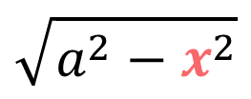
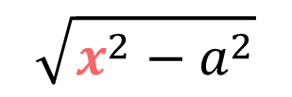

Cambios de variable
Caso 1
$$\sqrt{a^{2}−x^{2}}$$
$$x=a sen θ$$
Caso 2
$$\sqrt{a^{2}+x^{2}}$$
$$x=a tan θ$$
Caso 3
$$\sqrt{x^{2}−a^{2}}$$
$$x=a sec θ$$

Slide 5

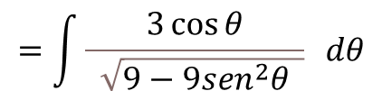
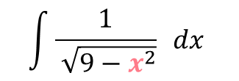
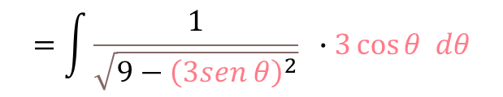
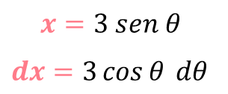
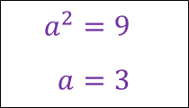
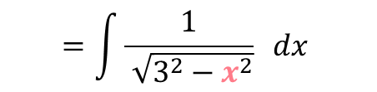
Caso 1
En las integrales que contienen un término de la forma $\sqrt{a^{2}−x^{2}}$ usaremos $x=a sen θ$
Ejercicio 1
$$\int{\frac{1}{ \sqrt{9−x^{2}}}} dx$$
$$=\int{\frac{1}{ \sqrt{3^{2}−x^{2}}}} dx$$
$$a^{2}=9$$
$$a=3$$
Cambio de variable
$$x=3 sen θ$$
$dx=3\cos{θ} dθ$
Aplicaremos derivada
$$=\int{\frac{1}{\sqrt{9−{\left(3sen θ\right)}^{2}}}} ∙3\cos{θ dθ}$$
$$=\int{\frac{3\cos{θ}}{ \sqrt{9−{9sen}^{2}θ }}} dθ$$

Slide 6
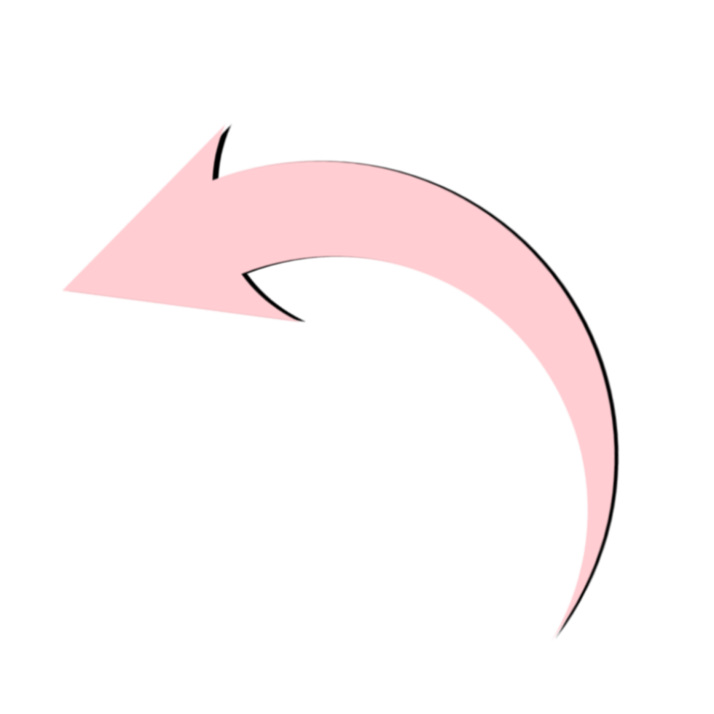

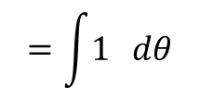
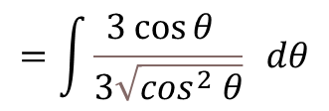
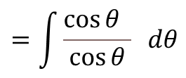



Caso 1
$$=\int{\frac{3\cos{θ}}{\sqrt{9\left(1−{sen}^{2}θ\right)}}} dθ$$
$$\cos^{2}{θ=1−{sen}^{2} θ}$$
$$=\int{\frac{3\cos{θ }}{3\sqrt{\cos^{2} θ}}} dθ$$
$$=\int{\frac{\cos{θ }}{\cos{θ}}} dθ$$
$$=\int{1} dθ$$
$$=θ+C$$

Slide 7
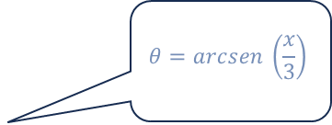
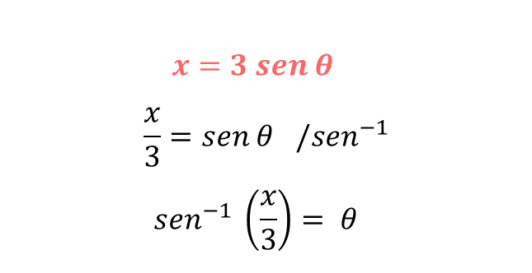

Caso 1
Para cambiar a la variable original usaremos
$$x=3 sen θ$$
$$\frac{x}{3}=sen θ /{sen}^{−1}$$
$${sen}^{−1} \left(\frac{x}{3}\right)= θ$$
$$θ=arcsen \left(\frac{x}{3}\right)$$
Obteniendo la respuesta
$$\int{\frac{1}{\sqrt{9−x^{2}}} dx }=θ+C= arcsen\left(\frac{x}{3}\right)+C$$

Slide 8
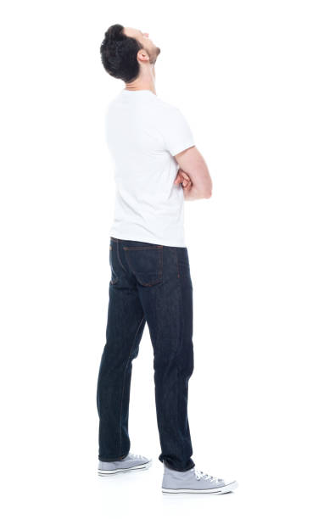
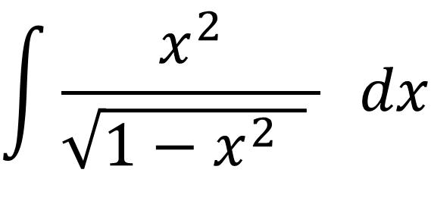
Ejercicio 1
$$\int{\frac{x^{2}}{\sqrt{{1−x}^{2} } } dx }$$
¿ Qué cambio usamos ?

Slide 9
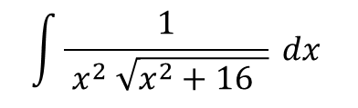
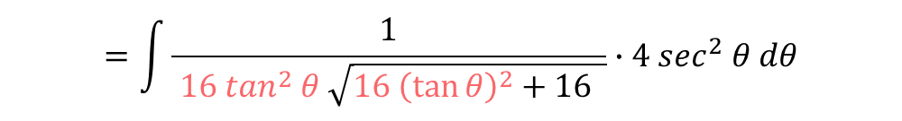
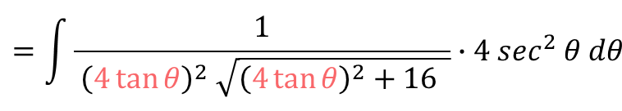
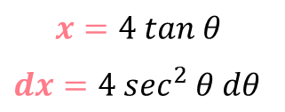
Caso 2
En las integrales que contienen un término de la forma $\sqrt{a^{2}+x^{2}}$ usaremos $x=a\tan{θ}$
Ejercicio 2
$$\int{\frac{1}{ x^{2} \sqrt{x^{2}+16 }} dx }$$
Cambio de variable
$$=\int{\frac{1}{ {\left(4\tan{θ}\right)}^{2} \sqrt{{\left(4\tan{θ}\right)}^{2}+16 }}∙4 \sec^{2} θ dθ}$$
$$x=4 tan θ$$
$dx=4 \sec^{2} θ dθ$
$$=\int{\frac{1}{ {16 tan}^{2} θ \sqrt{{16 \left(\tan{θ}\right)}^{2}+16 }}∙4 \sec^{2} θ dθ}$$

Slide 10





Caso 2
$$=\int{\frac{4\sec^{2} θ}{ {16 tan}^{2}θ \sqrt{16 ( \tan^{2}θ+1) }} dθ}$$
$\tan^{2}θ+1= \sec^{2} θ$
$$=\int{\frac{\sec^{2} θ}{ {4 tan}^{2}θ \sqrt{16 \sec^{2}θ }} dθ}$$
$$=\int{\frac{\sec^{2} θ}{ {4 tan}^{2} θ ∙4\sec{θ}} dθ}$$
$$=\frac{1}{16}\int{\frac{\sec{θ}}{ \tan^{2} θ } dθ}$$

Slide 11
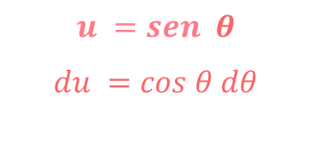





Caso 2
$$=\frac{1}{16} \int{\frac{\frac{1}{\cos{θ}}}{ \frac{{ sen}^{2} θ}{\cos^{2}θ} } dθ}$$
$$=\frac{1}{16} \int{\frac{\cos^{2}θ}{{ \cos{θ }sen}^{2} θ } dθ}$$
$$u =sen θ$$
$$du =cos θ dθ$$
$$=\frac{1}{16} \int{\frac{\cos{θ}}{{ sen}^{2} θ } dθ}$$
$$=\frac{1}{16} \int{ \frac{1}{{ u}^{2} } du }$$
$$=\frac{1}{16}\int{u^{−2} du}$$

Slide 12



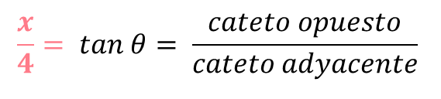








Caso 2
$$=\frac{1}{16} ∙ \frac{u^{−1}}{−1 } +C$$
$$u =sen θ$$
$$=− \frac{1}{ 16u } +C$$
Cambio de variable
$$x=4 tan θ$$
$$=− \frac{1}{ 16 sen θ } +C$$
$$\frac{x}{4}= tan θ= \frac{cateto opuesto}{cateto adyacente}$$
$$=− \frac{1}{ 16∙ \frac{x}{\sqrt{x^{2}+16}} } +C$$
$$\sqrt{x^{2}+16}$$
$$x$$
$$=− \frac{\sqrt{x^{2}+16}}{ 16x} +C$$
$$θ$$
$$4$$

Slide 13
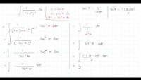
Ejercicio 2

Slide 14
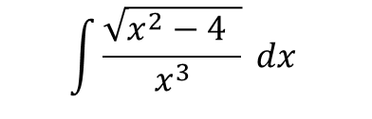
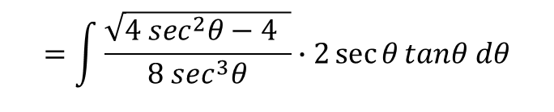
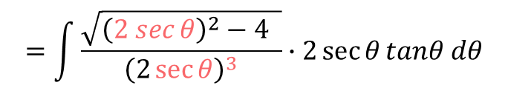
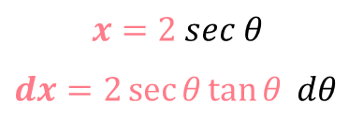
Caso 3
En las integrales que contienen un término de la forma $\sqrt{x^{2}−a^{2}}$ usaremos $x=a\sec{θ}$
Ejercicio
$$\int{\frac{\sqrt{x^{2}−4 }}{ x^{3} } dx }$$
Cambio de variable
$$=\int{\frac{\sqrt{{\left(2 sec{θ}\right)}^{2}−4 }}{ {\left(2\sec{θ}\right)}^{3} }∙2\sec{θ}tanθ dθ}$$
$$x=2 sec θ$$
$dx=2\sec{θ}\tan{θ} dθ$
$$=\int{\frac{\sqrt{4 \sec^{2}θ−4 }}{ {8 sec}^{3}θ }∙2\sec{θ}tanθ dθ}$$

Slide 15

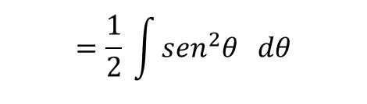

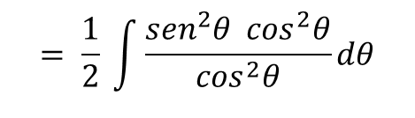
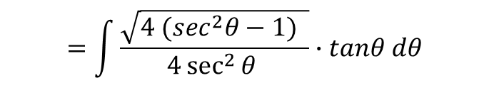
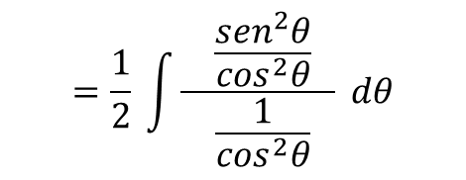


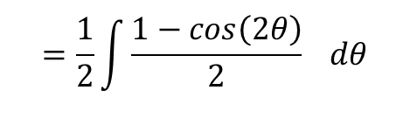
Caso 3
$$=\int{\frac{\sqrt{4 {(sec}^{2}θ−1) }}{4\sec^{2}{θ} }∙tanθ dθ}$$
$$=\frac{1}{2} \int{\frac{ \frac{{sen}^{2}θ}{\cos^{2}θ} }{ \frac{1}{\cos^{2}θ}} dθ}$$
$$=\int{\frac{\sqrt{4 \tan^{2}θ }}{4\sec^{2}{θ}}∙tanθ dθ}$$
$$= \frac{1}{2} \int{\frac{{sen}^{2}θ\cos^{2}θ}{\cos^{2}θ}dθ}$$
$$=\int{\frac{2\tan{θ}}{4\sec^{2}{θ}}∙tanθ dθ}$$
$$=\frac{1}{2} \int{{sen}^{2}θ dθ}$$
$$=\frac{1}{2}\int{\frac{1−cos\left(2θ\right)}{2} dθ}$$
$$=\int{\frac{\tan^{2}{θ}}{2\sec^{2}{θ}} dθ}$$

Slide 16

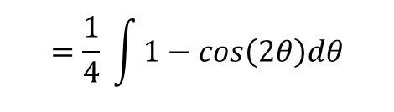


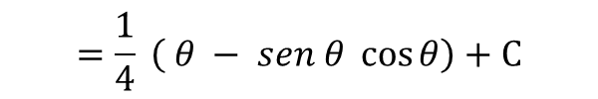
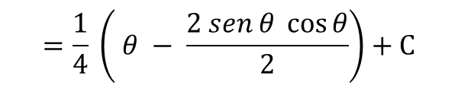
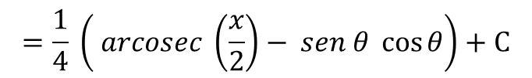
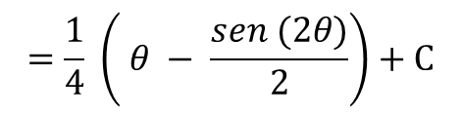
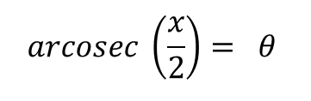
Caso 3
$$=\frac{1}{4} \int{1−cos\left(2θ\right)dθ}$$
Cambio de variable
$x=2 sec θ$
$$=\frac{1}{4} \left( θ − \frac{sen (2θ)}{2}\right)+C$$
$\frac{x}{2}= sec θ /\sec^{−1}$
$$=\frac{1}{4} \left( θ − \frac{2 sen θ \cos{θ}}{2}\right)+C$$
$\sec^{−1} \left(\frac{x}{2}\right)= θ /\sec^{−1}$
$$arcosec \left(\frac{x}{2}\right)= θ$$
$$=\frac{1}{4} \left( θ − sen θ \cos{θ}\right)+C$$
$$=\frac{1}{4} \left( arcosec \left(\frac{x}{2}\right)− sen θ \cos{θ}\right)+C$$

Slide 17

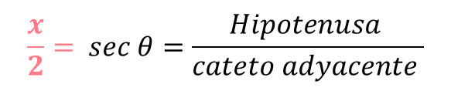


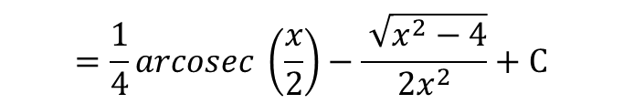

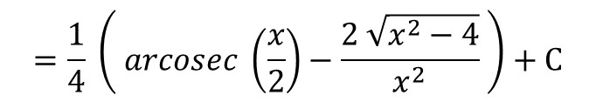
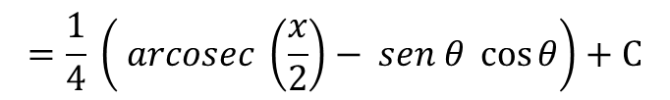
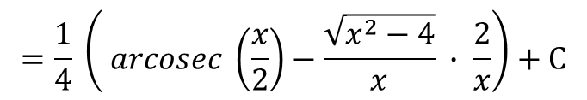
Caso 3
Cambio de variable
$$=\frac{1}{4} \left( arcosec \left(\frac{x}{2}\right)− sen θ \cos{θ}\right)+C$$
$x=2 sec θ$
$$=\frac{1}{4} \left( arcosec \left(\frac{x}{2}\right)−\frac{\sqrt{x^{2}−4}}{x} ∙ \frac{2}{x}\right)+C$$
$$\frac{x}{2}= sec θ=\frac{Hipotenusa }{cateto adyacente }$$
$$=\frac{1}{4} \left( arcosec \left(\frac{x}{2}\right)−\frac{2 \sqrt{x^{2}−4}}{x^{2}} \right)+C$$
$$x$$
$$=\frac{1}{4}arcosec \left(\frac{x}{2}\right)−\frac{ \sqrt{x^{2}−4}}{2x^{2}}+C$$
$$\sqrt{x^{2}−4}$$
$$θ$$
$$2$$

Slide 18
uvm.cl

